Slide 1
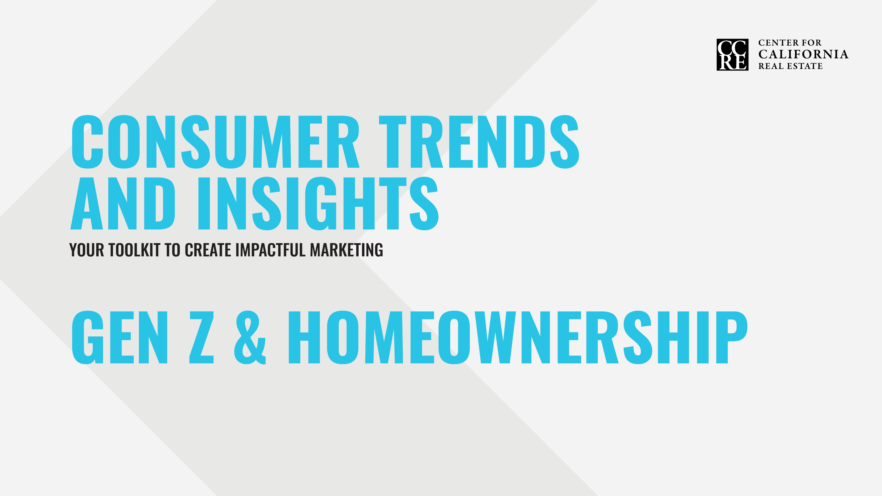

Slide 2
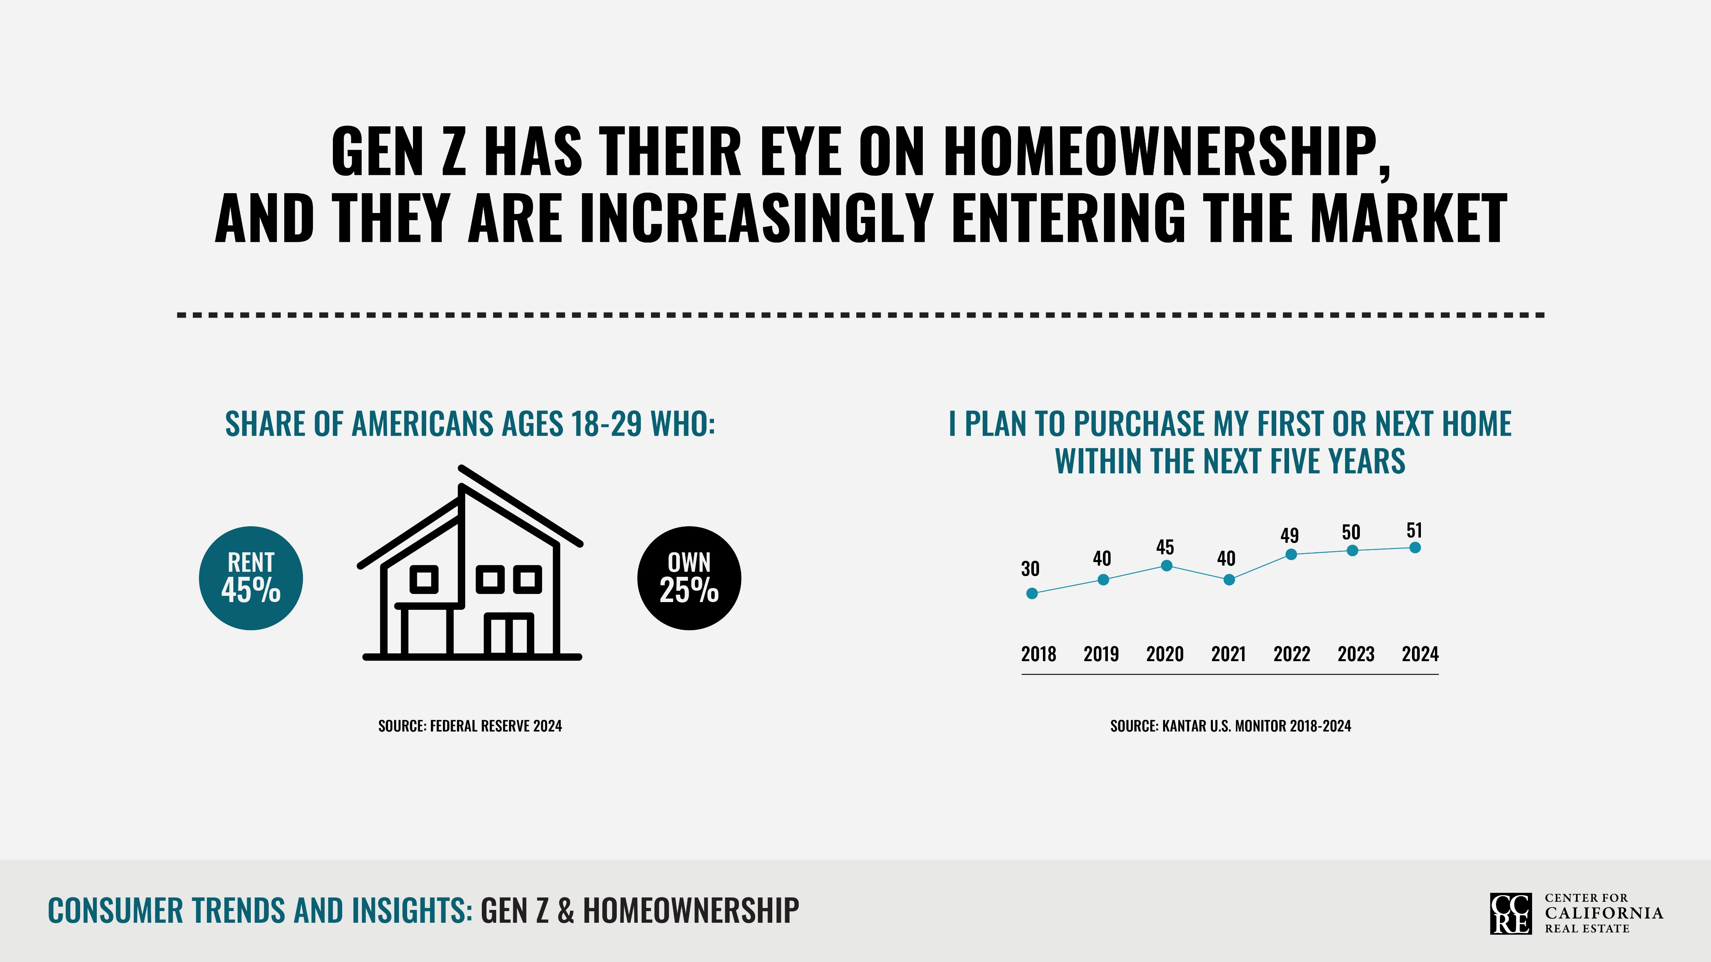
Notes:
Half of Gen Z plan to buy in the next five years—a marked increase since 2018. And nearly two-thirds say they already feel educated about the home-buying process.

Slide 3
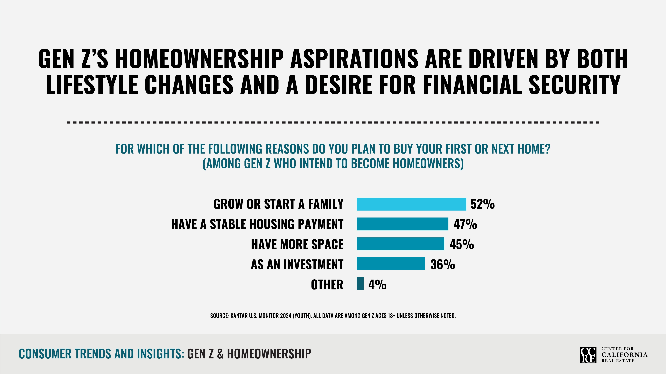
Notes:
Like many homebuyers, the primary reason most Gen Zs plan to buy a home is to start or grow a family. Stable payments and more space are a close second. For a generation that has been raised amid volatility and high rental prices, it’s easy to see why the predictability of a fixed-rate mortgage is appealing.

Slide 4
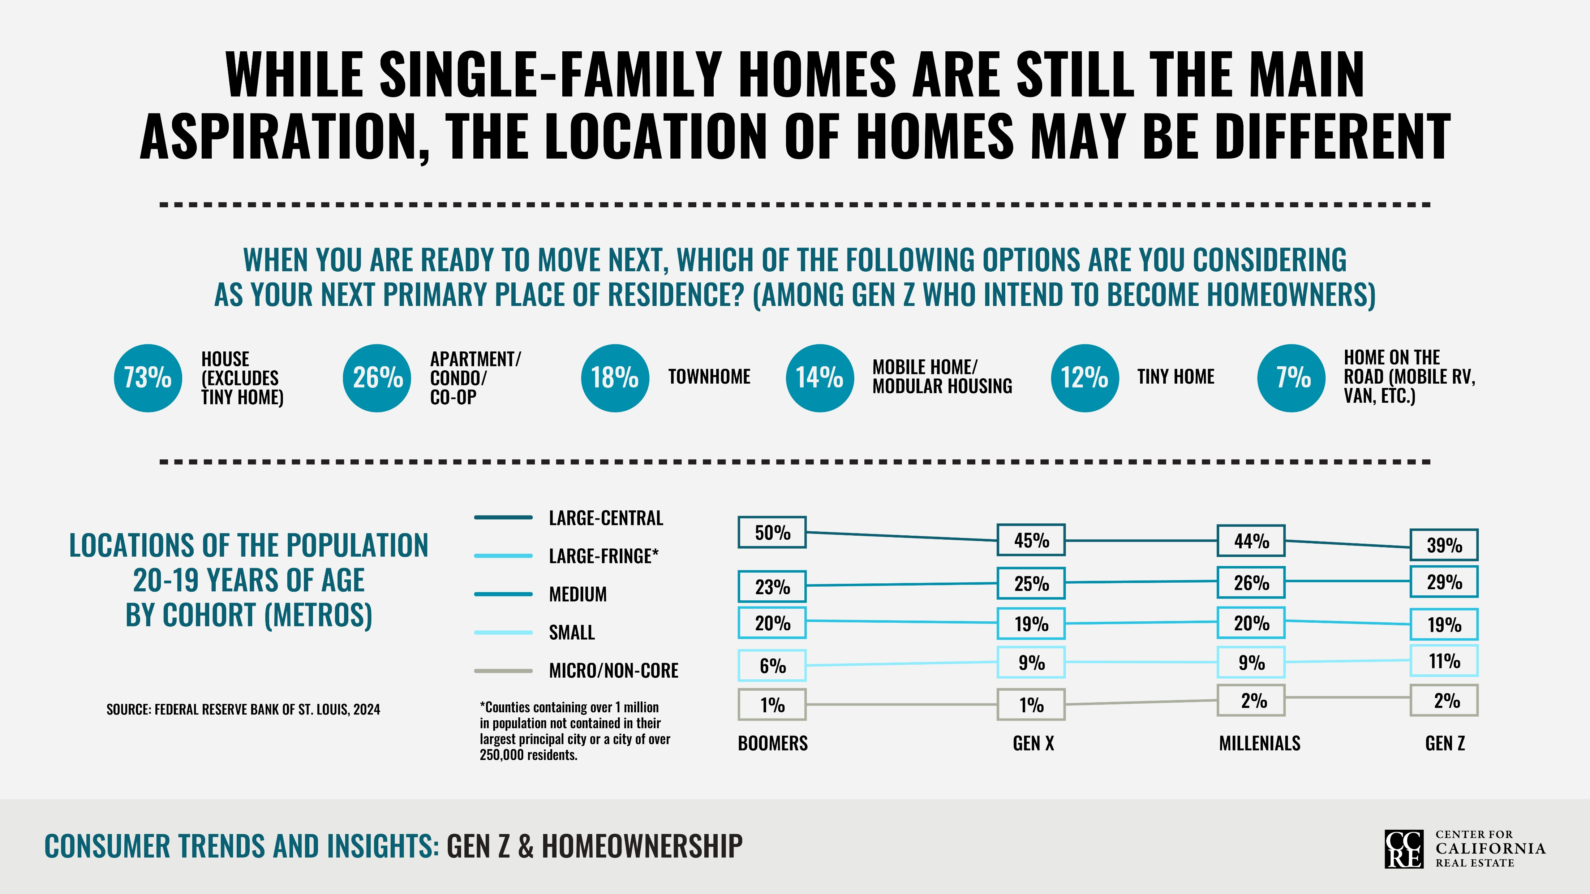
Notes:
Most Gen Z prefer to live in single-family homes, with just over a quarter interested in condos and apartments. Trendier options like tiny homes on the road only appeal to a small subset of Gen Zs nationally, though local housing markets might impact preferences.
Where young people are choosing to purchase homes may be shifting. Fewer people in their 20s are residing in large urban centers. A growing number are choosing small and medium-sized metro areas.

Slide 5
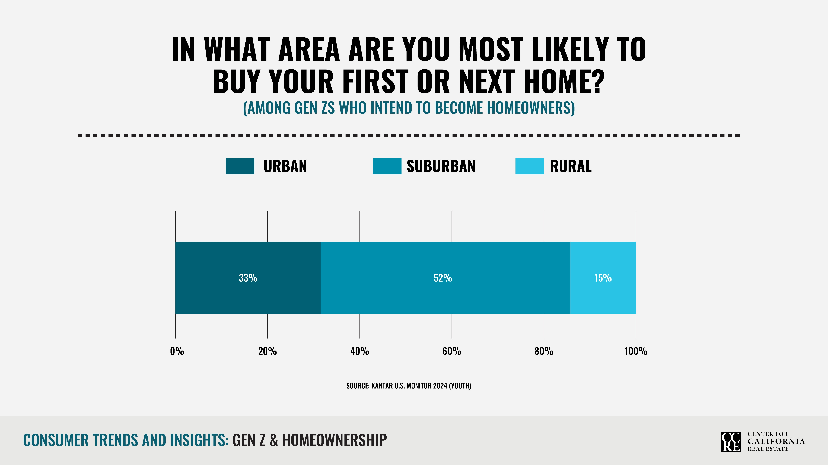
Notes:
Whether driven by affordability, preference or both, 52% of Gen Z who plan to own a home want to purchase in suburban areas, versus 33% in urban areas and 15% in rural areas.

Slide 6
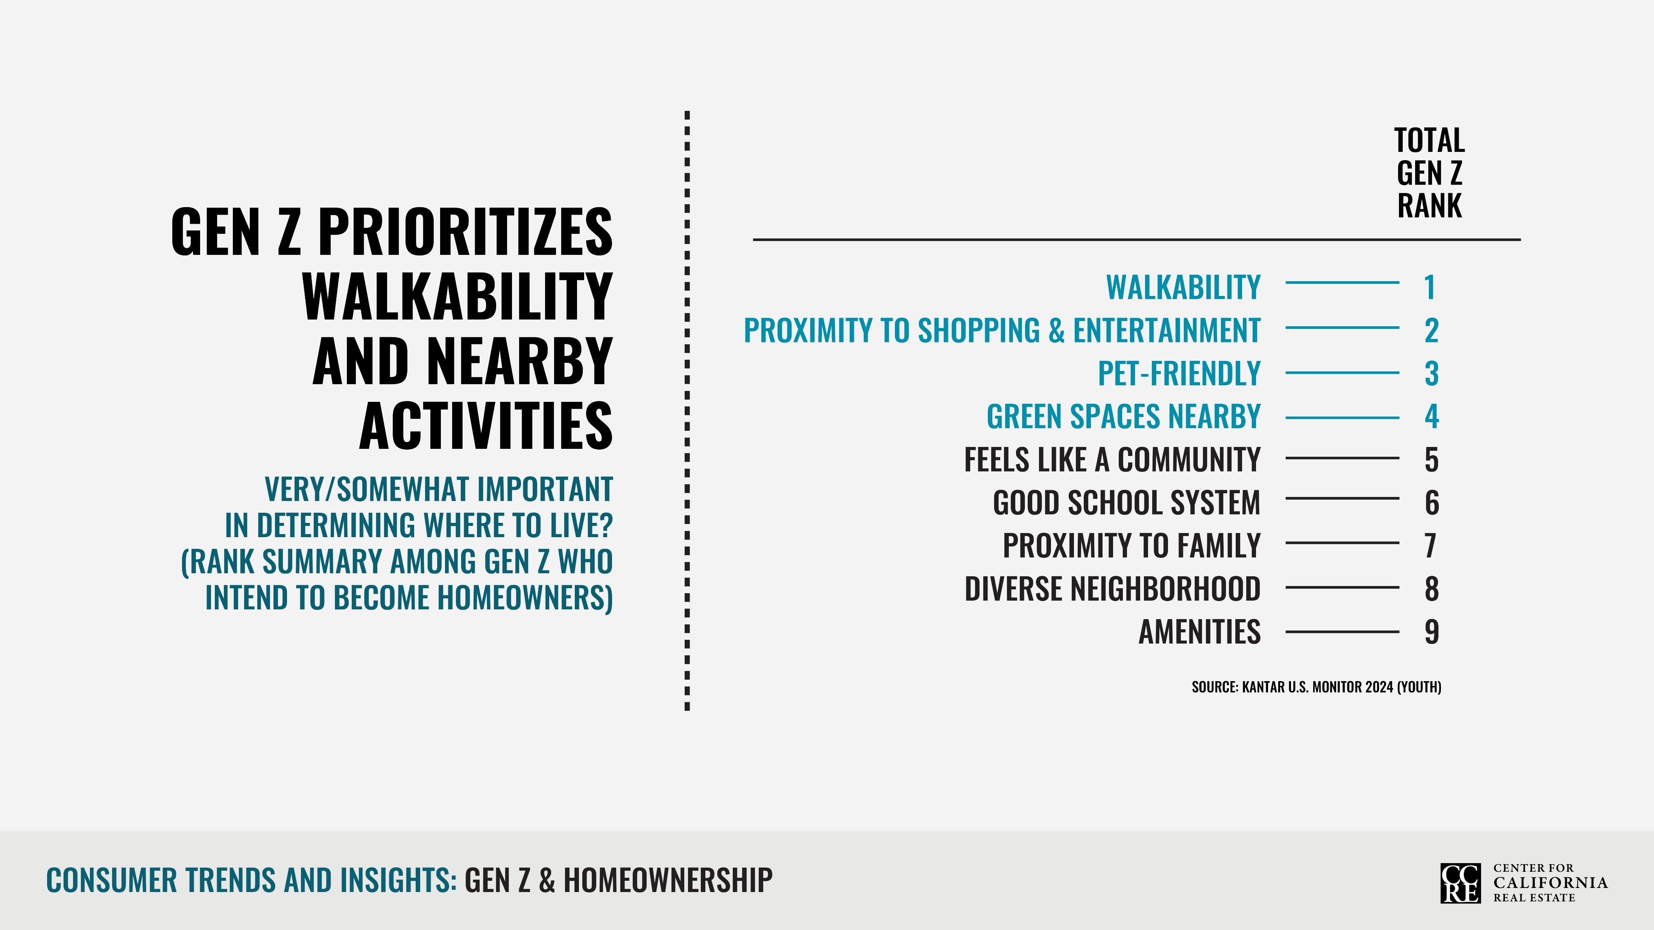
Notes:
Gen Zs want to live close to the things that make their lives easier and more enjoyable, whether that means shopping centers, attractions or green spaces. Pet-friendliness also ranks high.

Slide 7
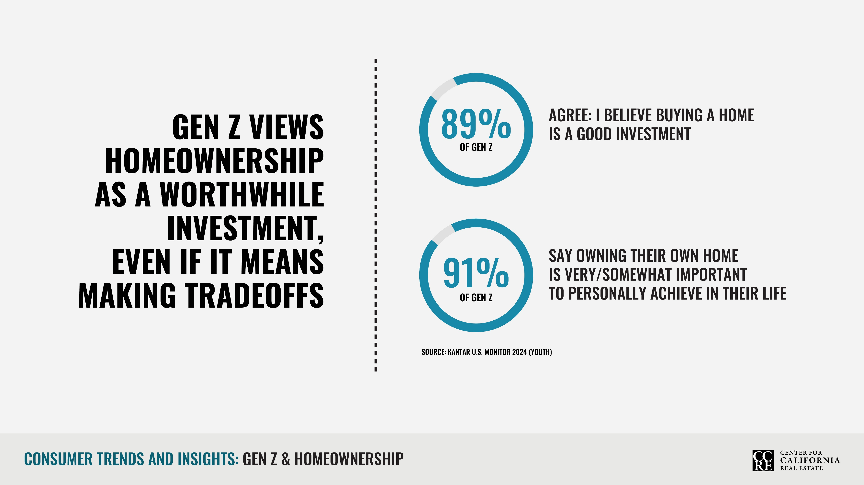
Notes:
Despite the challenging housing market environment, Gen Z still believes in the value of home ownership and nearly all — 9 in 10 — aspire to become homeowners one day. Gen Z’s starter homes may simply look different than planned. Buyers may trade off on size, location or amenities to achieve their dream of owning a home.

